Slide 1
Text based analysis to determine the usefulness of an online review
Rob Rupprath
UIUC CS410
December 21st, 2017

Slide 2
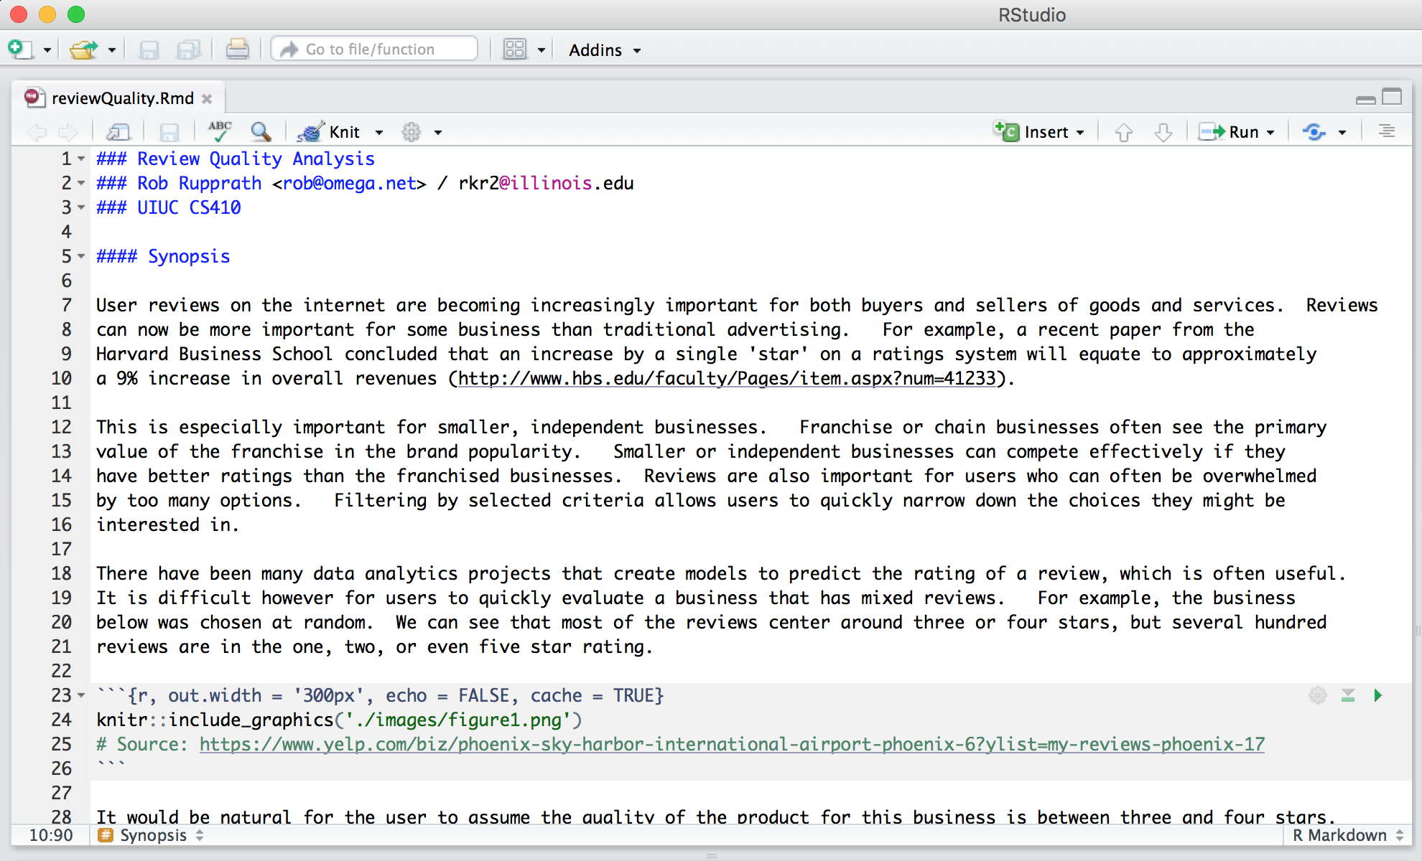
How to load and install the software
Rstudio using the Knittr package for R markdown
Additional packages should be installed automatically using pacman as the package manager, but are listed on line 73
Data is included in the repository, but can be downloaded directly from Yelp if desired
The markdown caches several of the longer processing functions

Slide 3
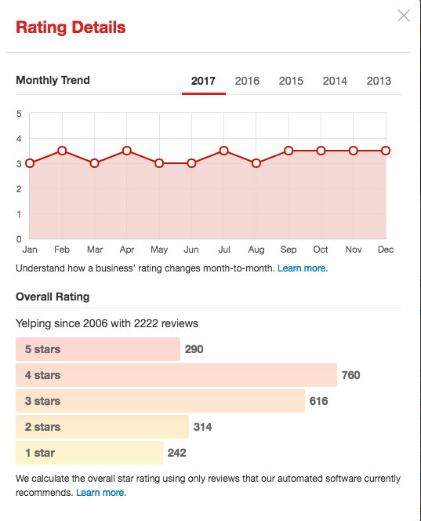
Why is this needed?
The number of reviews can be overwhelming
Reviews often span the full spectrum of star ratings
Useful information can be gathered from both positive or negative reviews

Slide 4
Examples of useful information
Text reviews that aren’t particularly useful:
(Five Stars) - This place was great!
(Three Stars) - It was ok
(Two Stars) - I hated it
Text reviews that can be quite useful:
(Five Stars) - Choose the kale salad. It is the best!
(Three Stars) - I went early on a Friday and still had to wait an hour because I didn't have a reservation
(One Star) - They charge $20 for parking! How ridiculous!

Slide 5
About the data
Yelp – one of the most popular review sites online
7m+ records
Observed ranking through ’helpful’ tags
The full dataset can be accessed at: https://www.yelp.com/dataset
Please note that the R markdown used in this analysis caches many code segments that would take significant timeto process.
The cache for these segments has been included in the repository. If you choose to run the analysis without cache then it may take 10+ hours to complete

Slide 6
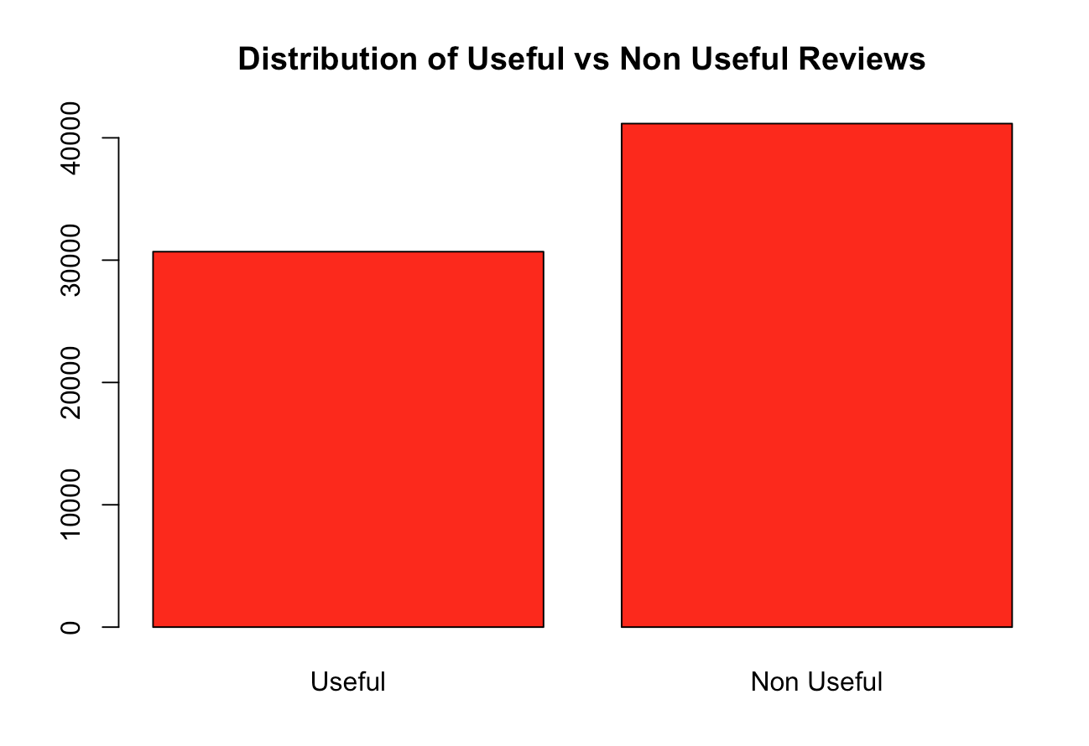
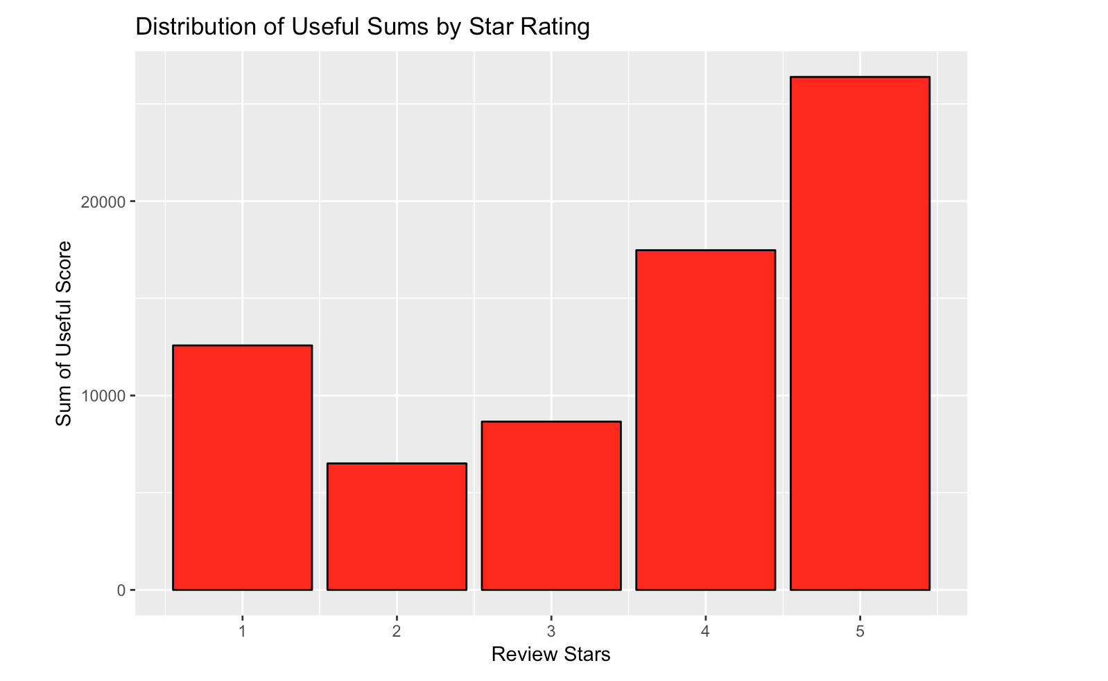
Initial data observations

Slide 7
Items derived from the data
Review length in words
Number of reviews a reviewer has completed
Sentiment analysis

Slide 8
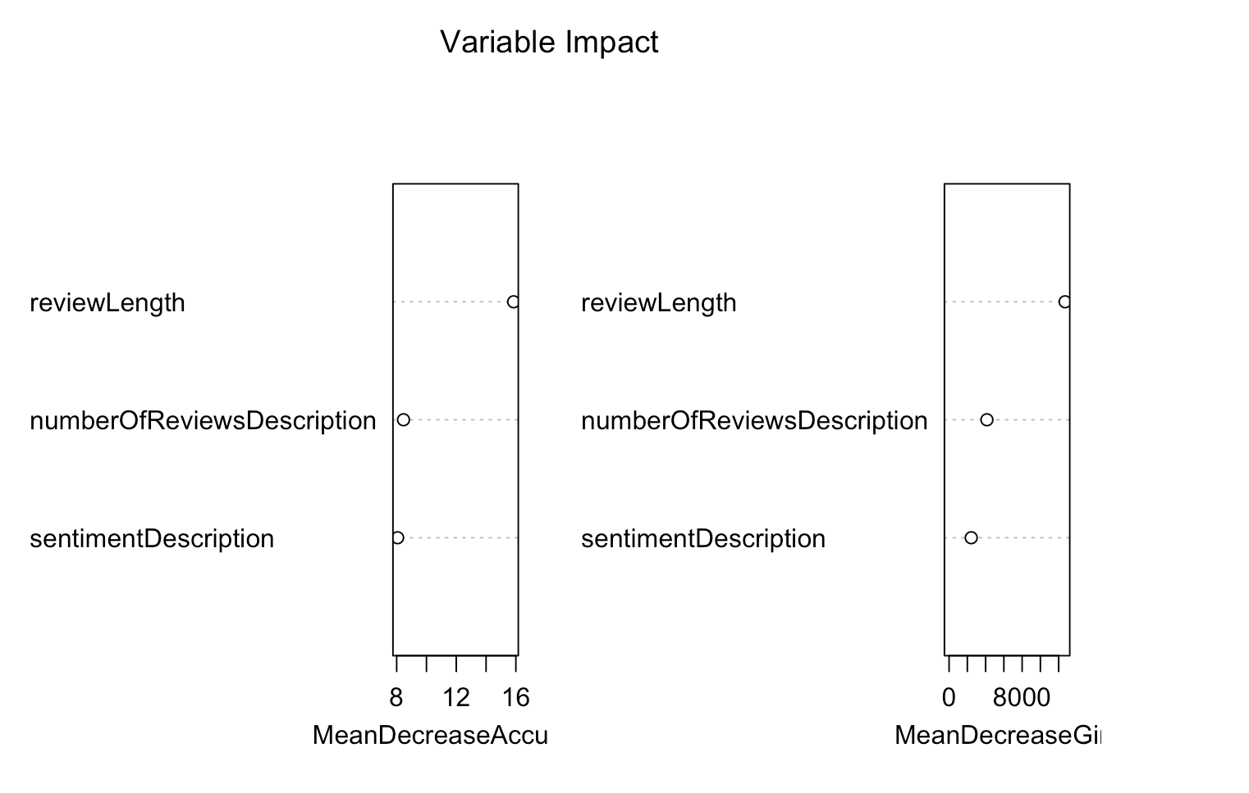
Model Creation and Results
Random Forest model
60.6% Precision
47.7% Recall

Slide 9
Additional thoughts
The number of reviews a user produced may be artificially low given we only sampled 1m out of the 7m+ reviews
Additional analysis of the review text could be performed. Examples include eliminating non-english reviews and punctuation / grammar checks
Additional data on the reviews could be utilized. For example, how long a user has been a reviewer

